Slide 1
Java Fundamentals
Multithreading in Java

Slide 2
Multithreading
It is a process of executing multiple threads simultaneously.
Multithreading is a Java feature that allows concurrent execution of two or more parts of a program for maximum utilization of CPU. Each part of such program is called a thread.
A thread is a lightweight sub-process, i.e. the smallest unit of processing.
Multiprocessing and multithreading, both are used to achieve multitasking.
However, multithreading is used than multiprocessing because threads use a shared memory area.
They don't allocate separate memory area so saves memory, and context-switching between the threads takes less time than process.

Slide 3
Importance of Java Multithreading
1) It doesn't block the user because threads are independent and you can perform multiple operations at the same time.
2) You can perform many operations together, so it saves time.
3) Threads are independent, so it doesn't affect other threads if an exception occurs in a single thread.

Slide 4
Multitasking
Multitasking is a process of executing multiple tasks simultaneously. Multitasking is used to utilize the CPU. Multitasking can be achieved in two ways:
1) Process-based Multitasking (Multiprocessing)
Each process has an address in memory i.e. separate memory area.
A process is heavyweight.
Cost of communication between the process is high.
Switching from one process to another requires some time for saving and loading registers, memory maps, updating lists, etc.
2) Thread-based Multitasking (Multithreading)
Threads share the same address space.
A thread is lightweight.
Cost of communication between the thread is low.

Slide 5
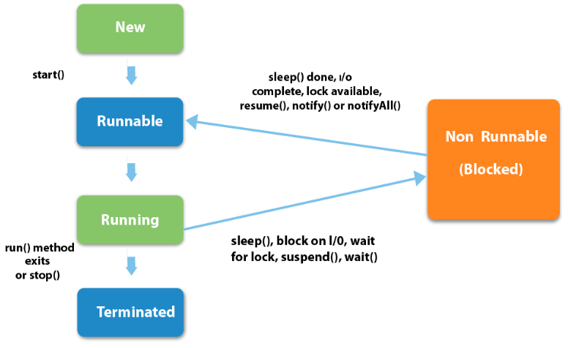
Lifecycle of a Thread

Slide 6
The life cycle of the thread in java is controlled by JVM. The java thread states are as follows:
New
Runnable
Running
Non-Runnable (Blocked)
Terminated

Slide 7
1) New- The thread is in new state if you create an instance of Thread class but before the invocation of start() method.
2) Runnable- The thread is in runnable state after invocation of start() method, but the thread scheduler has not selected it to be the running thread.
3) Running- The thread is in running state if the thread scheduler has selected it.
4) Non-Runnable (Blocked)- This is the state when the thread is still alive, but is currently not eligible to run.
5) Terminated- A thread is in terminated or dead state when its run() method exits.

Slide 8
Threads can be created by using two ways:
1. Extending the Thread class 2. Implementing the Runnable Interface

Slide 9
1. Extending the Thread class
We create a class that extends the java.lang.Thread class.
This class overrides the run() method available in the Thread class.
A thread begins its life inside run() method.
We create an object of our new class and call start() method to start the execution of a thread.
Start() invokes the run() method on the Thread object.

Slide 10
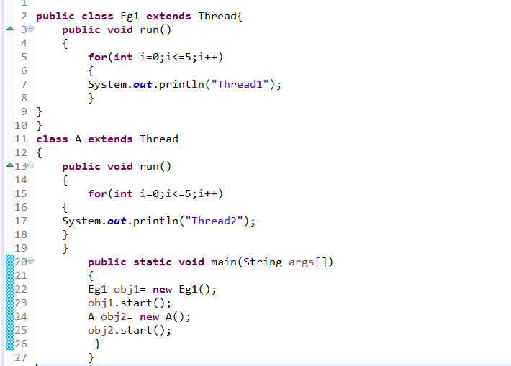

Slide 11
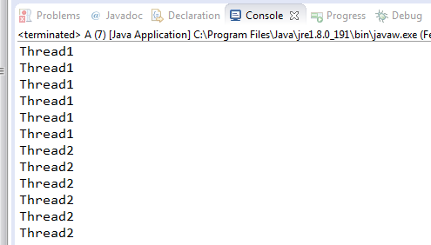
Output can be of any order. It depends on the Thread scheduler.

Slide 12
Thread creation by implementing the Runnable Interface
We create a new class which implements java.lang.Runnable interface and override run() method.
Then we instantiate a Thread object and call start() method on this object.

Slide 13
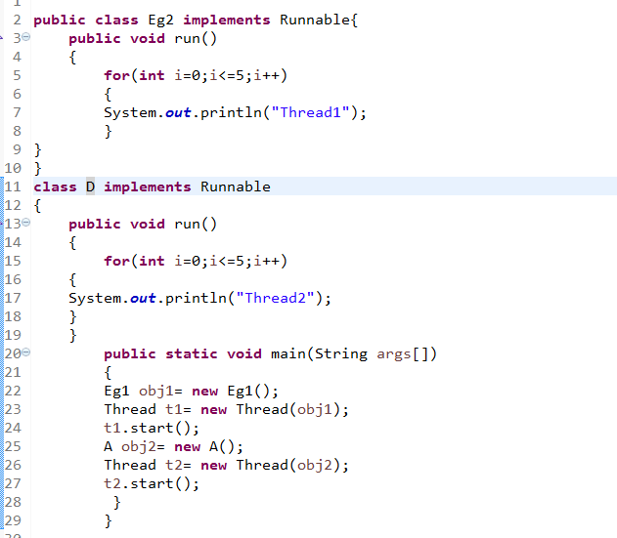

Slide 14
Output can be of any order. It depends on the Thread scheduler.

Slide 15
Thread Class vs Runnable Interface
1. If we extend the Thread class, our class cannot extend any other class because Java doesn’t support multiple inheritance.
But, if we implement the Runnable interface, our class can still extend other base classes. 2. We can achieve basic functionality of a thread by extending Thread class because it provides some inbuilt methods like yield(), interrupt() etc. that are not available in Runnable interface.

Slide 16
Thread Scheduler
Thread scheduler in java is the part of the JVM that decides which thread should run.
There is no guarantee that which runnable thread will be chosen to run by the thread scheduler.
Only one thread at a time can run in a single process.
The thread scheduler mainly uses preemptive or time slicing scheduling to schedule the threads.

Slide 17
Preemptive scheduling and time slicing
Preemptive scheduling: The highest priority task executes until it enters the waiting or dead states or a higher priority task comes into existence.
If a certain task is running and the scheduling method used is preemptive, and then if there is another task that has a higher priority than the executing task, then the executing task is preempted by the higher priority task.

Slide 18
Time slicing: A task executes for a predefined slice of time and then reenters the pool of ready tasks. The scheduler then determines which task should execute next, based on priority and other factors.
Time slicing scheduling has a time quantum (tq) value to CPU switches another contexts(process). Tq value determines how long process work in the CPU uninterruptly.

Slide 19
Sleep method in java
The sleep() method of Thread class is used to sleep a thread for the specified amount of time.
If you sleep a thread for the specified time,the thread schedular picks up another thread and run.
After starting a thread, it can never be started again. If you does so, an IllegalThreadStateException is thrown.
In such case, thread will run once but for second time, it will throw exception.

Slide 20
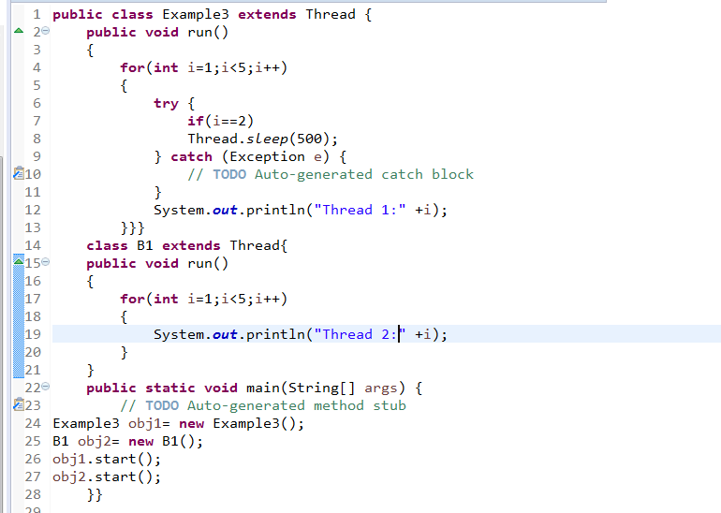

Slide 21
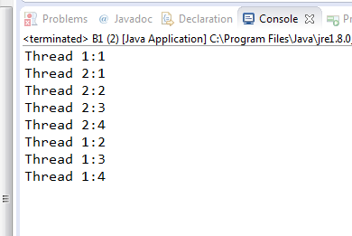

Slide 22
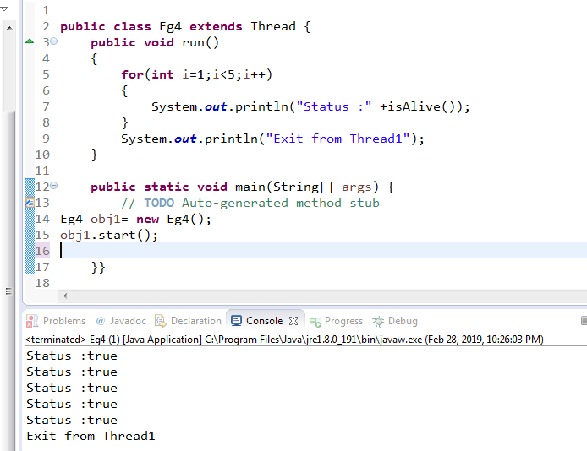
isALIVE method()

Slide 23
Join method
The join() method waits for a thread to die. In other words, it causes the currently running threads to stop executing until the thread it joins with completes its task.

Slide 24
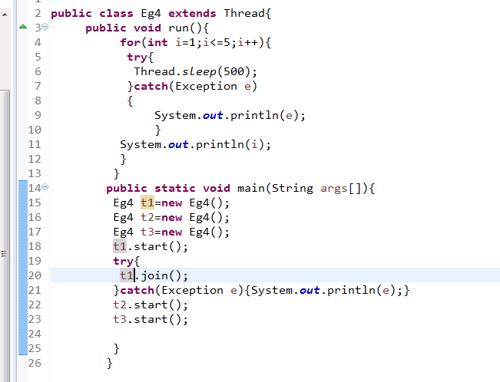

Slide 25
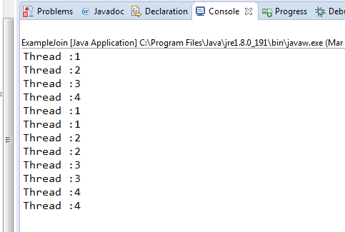

Slide 26
The currentThread() method
The currentThread() method returns a reference to the currently executing thread object.

Slide 27
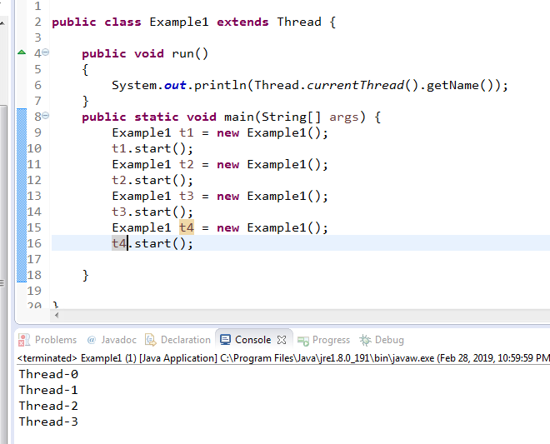

Slide 28
Priority of a Thread
Each thread have a priority.
Priorities are represented by a number between 1 and 10.
thread schedular schedules the threads according to their priority .
It depends on JVM specification that which scheduling it chooses.

Slide 29
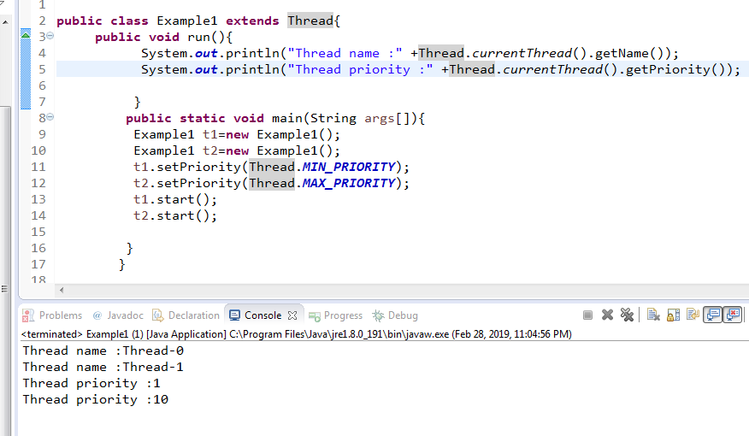

Slide 30
Types of Threads in Java
User Thread
Daemon Thread
User threads are high priority threads which always run in foreground. They are designed to do specific or complex task
Daemon threads are low priority threads which always run in background. They are used to perform supporting tasks. Eg. gc, finalizer etc.
The sole purpose of the daemon thread is that it provides services to user thread for background supporting task.

Slide 31
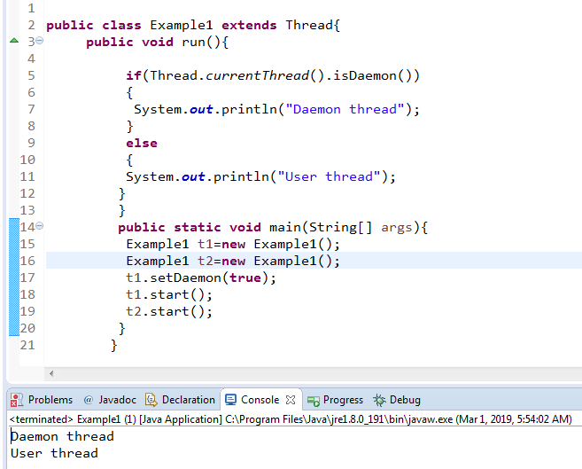

Slide 32
Difference between User Thread and Daemon Thread
JVM doesn’t wait for daemon thread to finish but it waits for any active User Thread.
Thread Priority : The User threads are high priority as compare to daemon thread means they won’t get CPU as easily as a user thread can get.
Creation of Thread : User thread is usually created by the application for executing some task concurrently. On the other hand, daemon thread is mostly created by JVM like for some garbage collection job.

Slide 33
4. Termination of Thread : JVM will force daemon thread to terminate if all user threads have finished their execution but The user thread is closed by application or by itself.
5. Usage : The daemons threads are not used for any critical task. Any important task is done by user thread. A daemon thread is generally used for some background tasks which are not critical task.

Slide 34
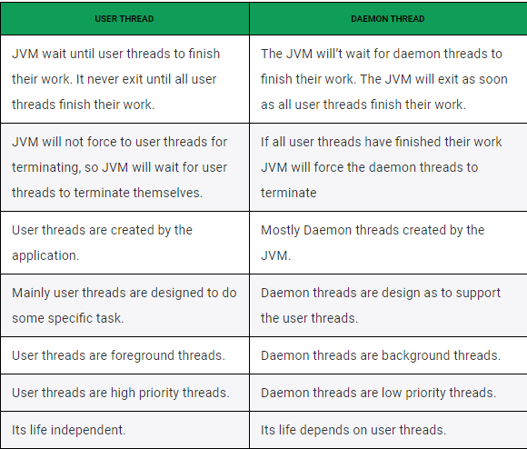

Slide 35
Synchronization
In Multi-threaded programs, sometimes multiple threads try to access the same resources and produce erroneous results.
So it needs to be made sure by some synchronization method that only one thread can access the resource at a given point of time.
Java provides a way of creating threads and synchronizing their task by using synchronized blocks.
Synchronized blocks in Java are marked with the synchronized keyword.
A synchronized block in Java is synchronized on some object.
All synchronized blocks synchronized on the same object can only have one thread executing inside them at a time.
All other threads attempting to enter the synchronized block are blocked until the thread inside the synchronized block exits the block.

Slide 36
Synchronization in java is the capability to control the access of multiple threads to any shared resource.
Java Synchronization is better option where we want to allow only one thread to access the shared resource.
The synchronization is mainly used to:
To prevent thread interference.
To prevent consistency problem.

Slide 37
Synchronization block in Java
Synchronized block can be used to perform synchronization on any specific resource of the method.
This synchronization is implemented in Java with a concept called monitors.
Only one thread can own a monitor at a given time.
When a thread acquires a lock, it is said to have entered the monitor. All other threads attempting to enter the locked monitor will be suspended until the first thread exits the monitor.

Slide 38
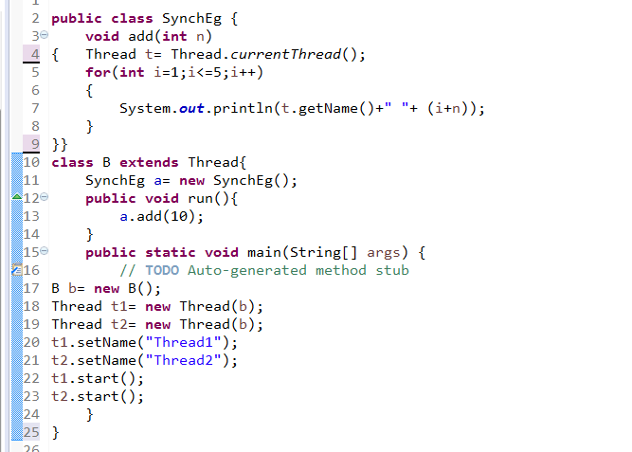

Slide 39
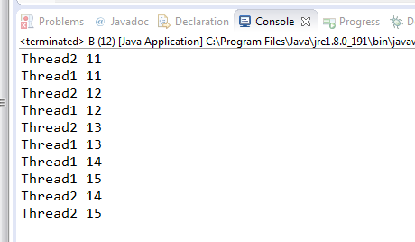

Slide 40
